Slide 1





TASK 2
CORONA VIRUS ANALYSIS WITH SQL
BY: DEEPANSHU JOSHI
PROFILE: DATA ANALYST INTERN
BATCH: MIP-DA-07

Slide 2



Contents
01
Introduction
02
Description Of Dataset
03
Database Setup and Tool Used
04
Question & Answer
05
Insights

Slide 3




01. Introduction
Project Overview
The global COVID-19 pandemic necessitates data-driven insights to understand its spread and impact on public health.
As a data analyst, the task is to analyze a Corona Virus dataset, utilizing SQL and data analysis skills to derive meaningful insights.
This project is a practical assessment of SQL proficiency and data analysis skills in a real-world context.
Through meticulous analysis, the aim is to contribute to understanding the COVID-19 crisis and inform evidence-based public health strategies.

Slide 4





02. Description Of Dataset
Description of each column in the dataset:
Province: Geographic subdivision within a country/region.
Country/Region: Geographic entity where data is recorded.
Latitude: North-south position on Earth's surface.
Longitude: East-west position on Earth's surface.
Date: Recorded date of CORONA VIRUS data.
Confirmed: Number of diagnosed CORONA VIRUS cases.
Deaths: Number of CORONA VIRUS-related deaths.
Recovered: Number of recovered CORONA VIRUS cases.

Slide 5


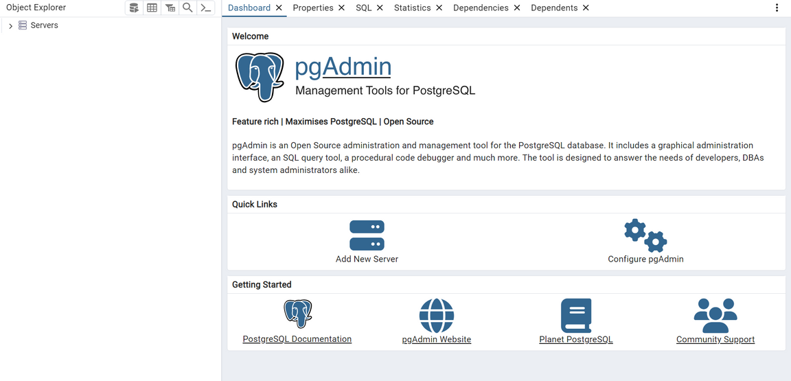
03. Database Setup & Tool Used
Database Used
Management Tool: pgAdmin4

Slide 6
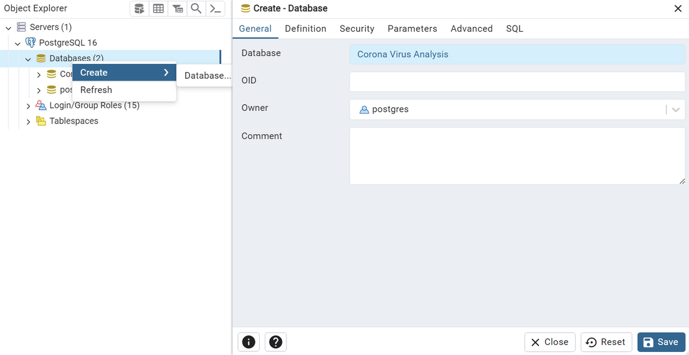
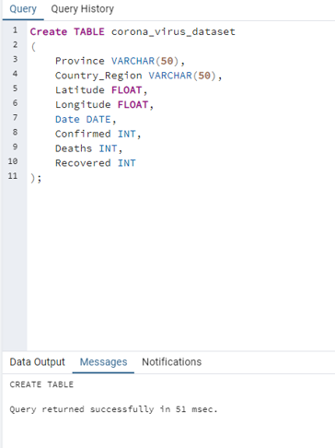
Database Setup and Table Creation
To Create Database:
To Create Table:

Slide 7
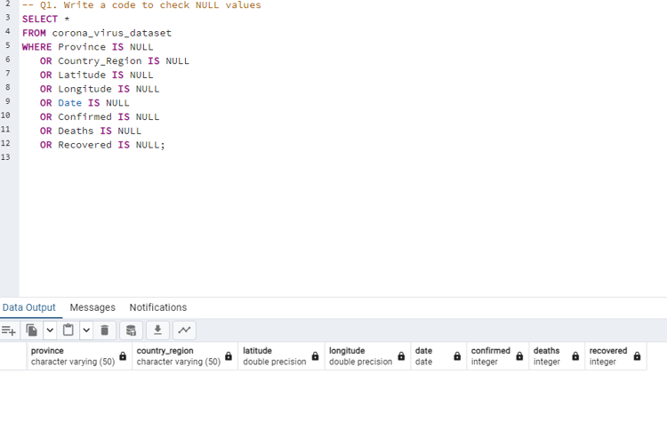
04. Question & Answers
Q1. Write a code to check NULL values

Slide 8


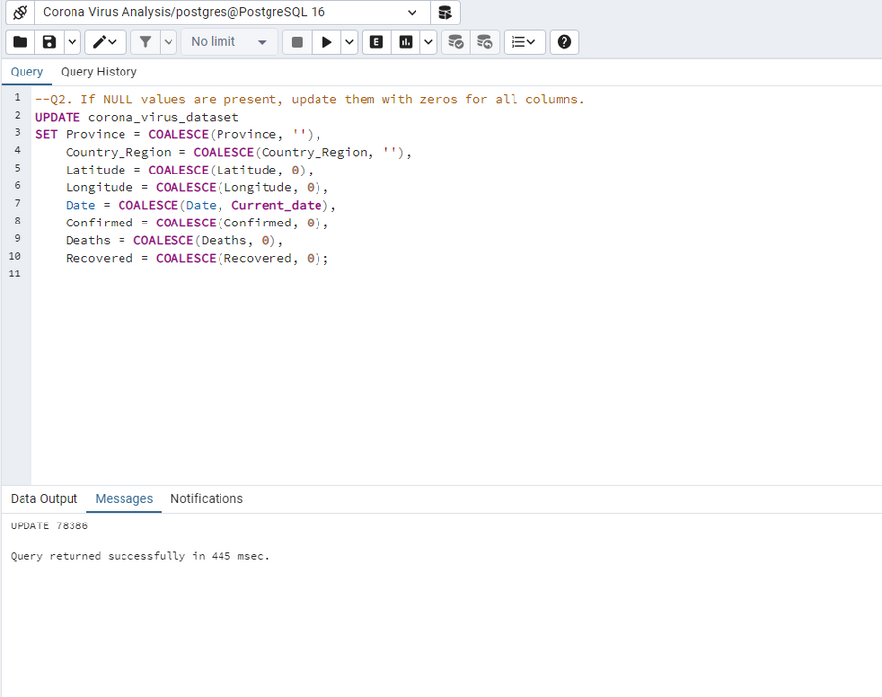
Q2. If NULL values are present, update them with zeros for all columns.
As we have already checked in the first query there are no null values but still, If the values were null from any column we can address them using this query.

Slide 9
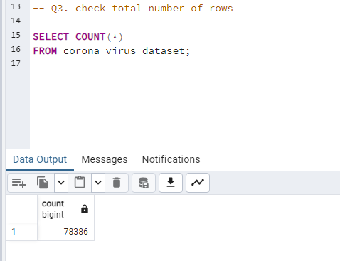
Q3. Check total number of rows

Slide 10
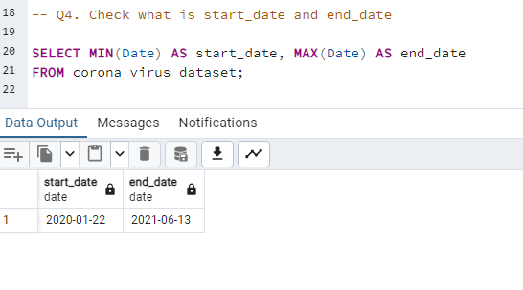
Q4. Check what is start_date and end_date.

Slide 11
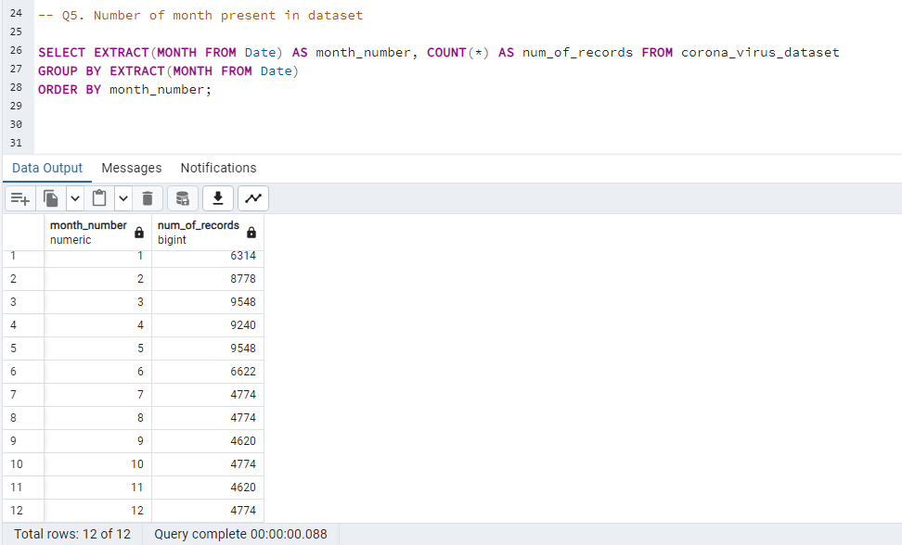
Q5. Number of month present in dataset

Slide 12
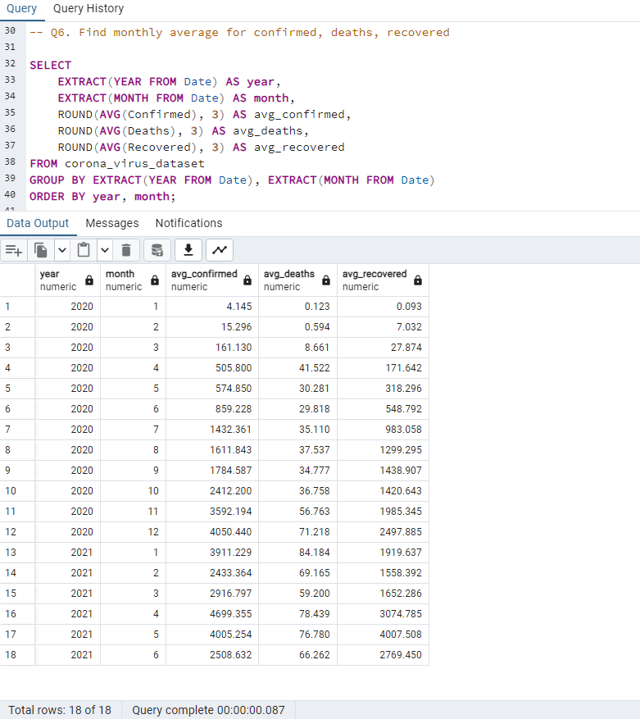
Q6. Find monthly average for confirmed, deaths, recovered.

Slide 13
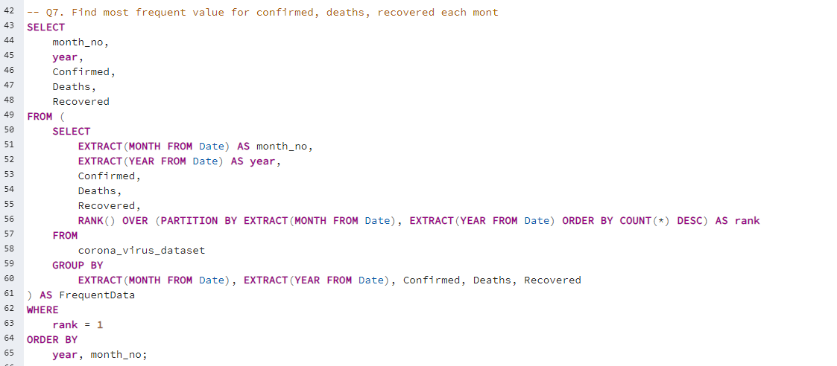
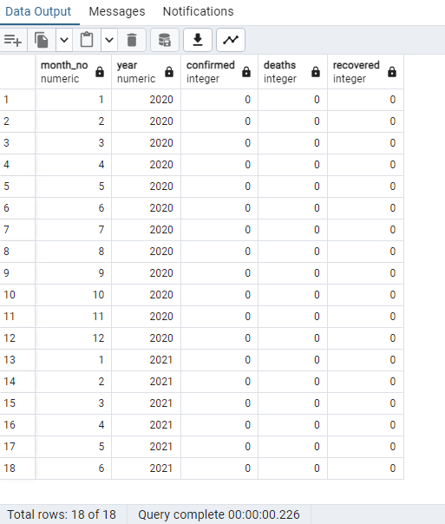
Q7. Find most frequent value for confirmed, deaths, recovered each month
Output:

Slide 14
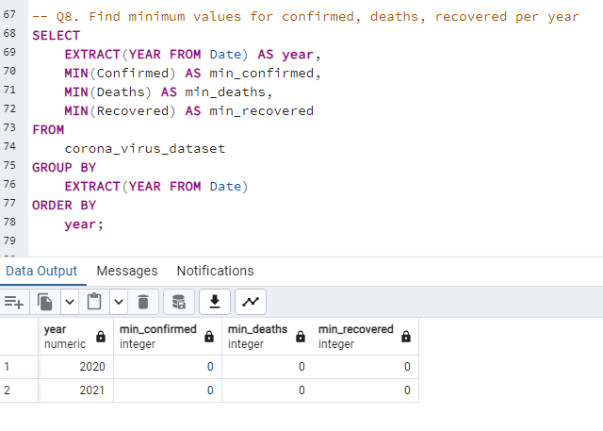
Q8. Find minimum values for confirmed, deaths, recovered per year.

Slide 15
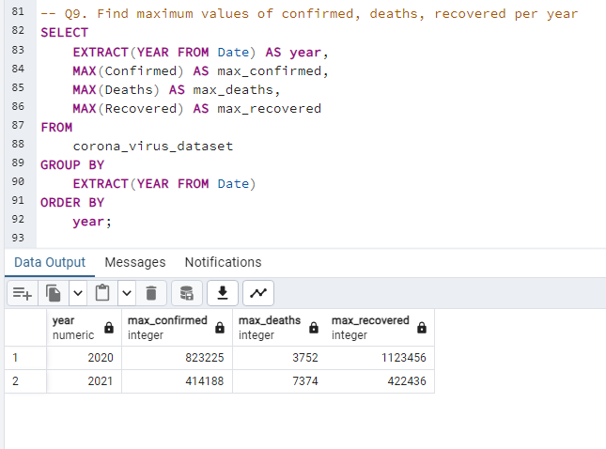
Q9. Find maximum values of confirmed, deaths, recovered per year.

Slide 16
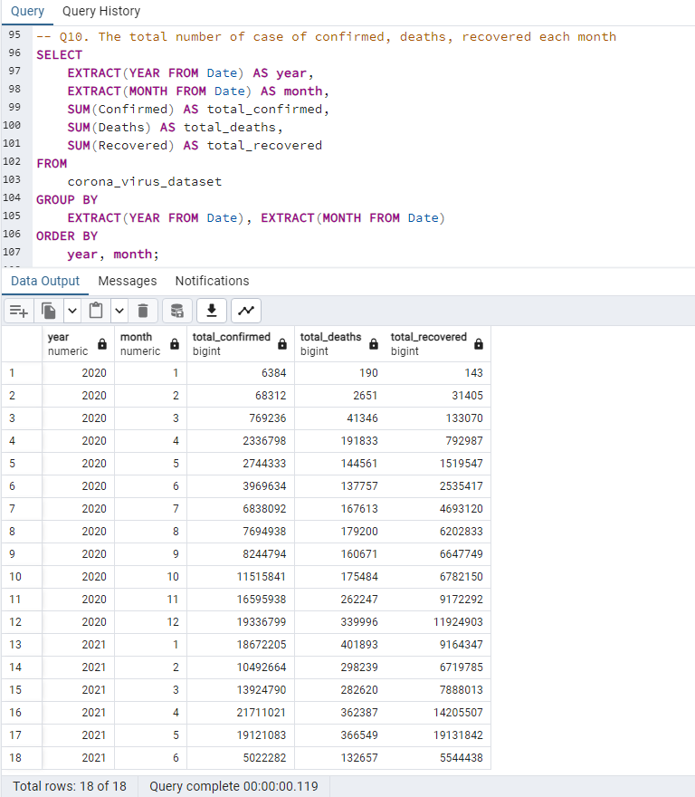
Q10. The total number of case of confirmed, deaths, recovered each month.

Slide 17
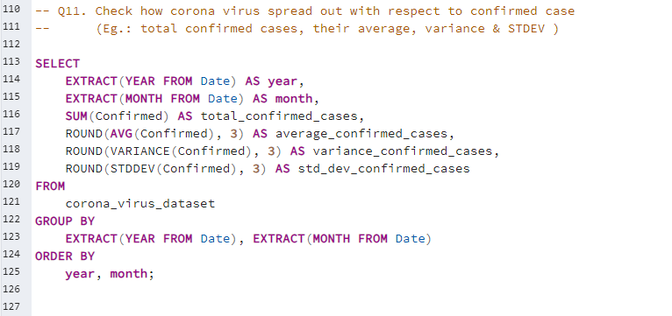
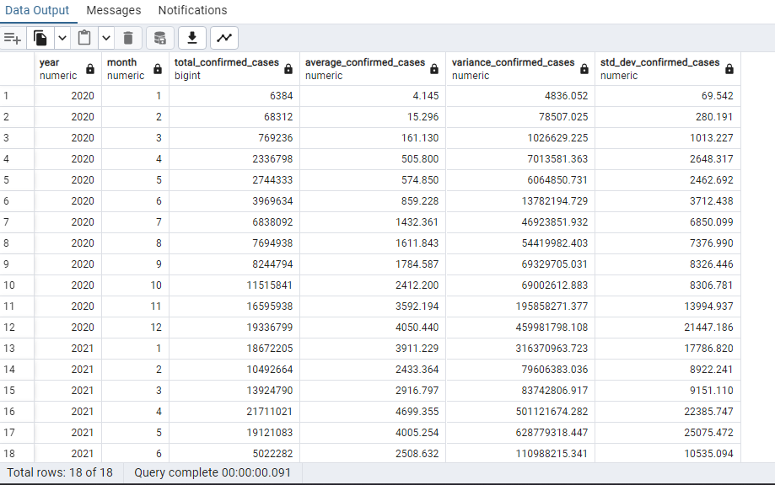
Q11. Check how corona virus spread out with respect to confirmed case
(Eg.: total confirmed cases, their average, variance & STDEV)
Output:

Slide 18
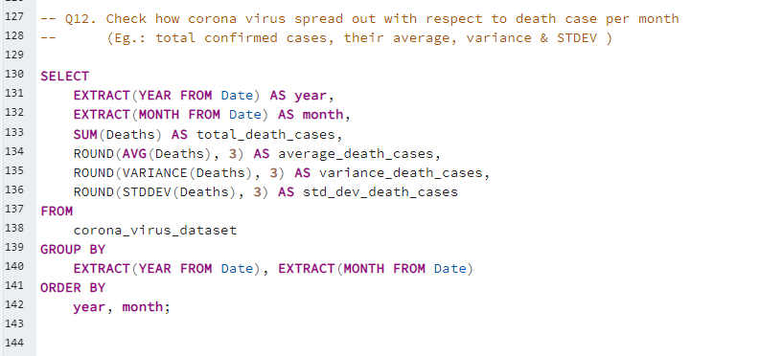
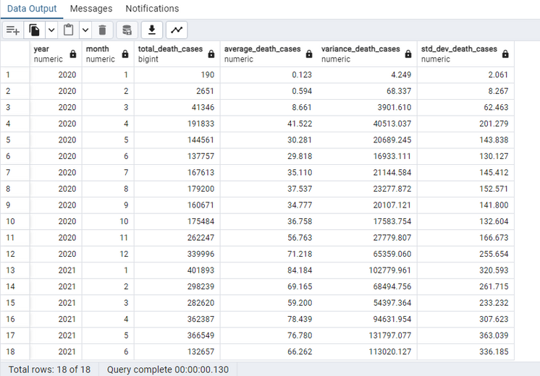
Q12. Check how corona virus spread out with respect to death case per month
(Eg.: total confirmed cases, their average, variance & STDEV )
Output:

Slide 19
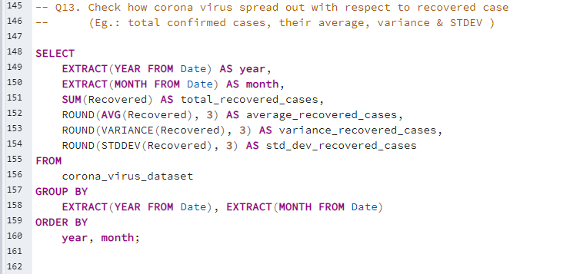
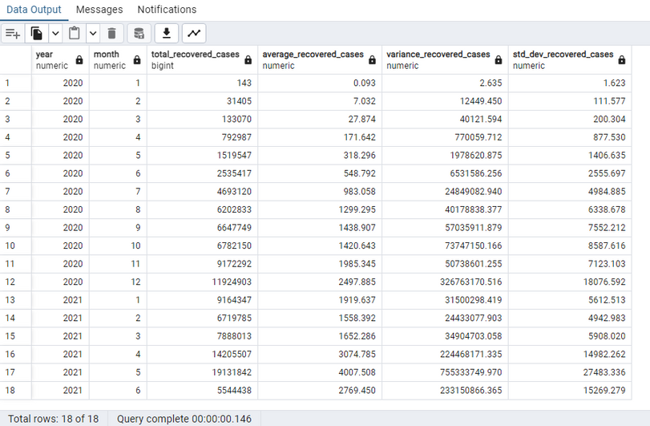
Q13. Check how corona virus spread out with respect to recovered case
(Eg.: total confirmed cases, their average, variance & STDEV)
Output:

Slide 20
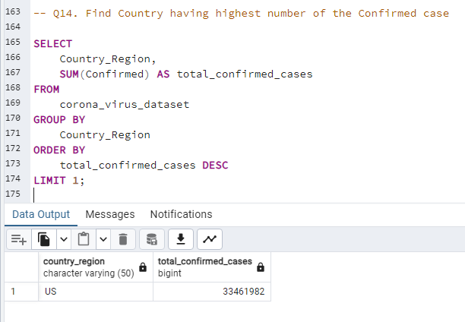
Q14. Find Country having highest number of the confirmed case

Slide 21
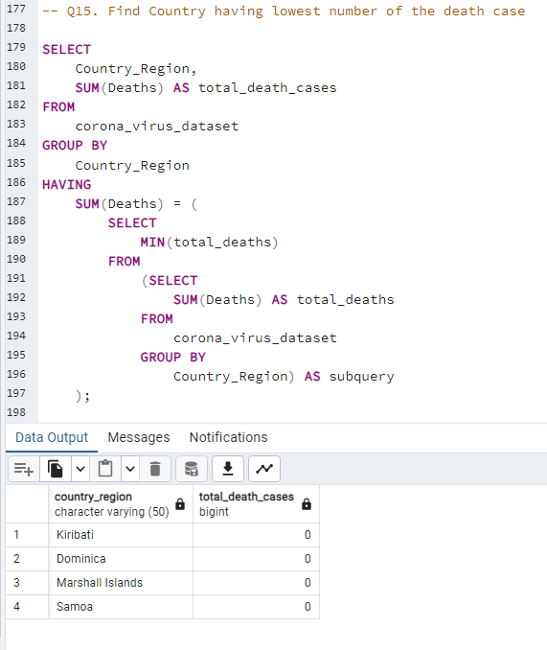
Q15. Find Country having lowest number of the death case

Slide 22
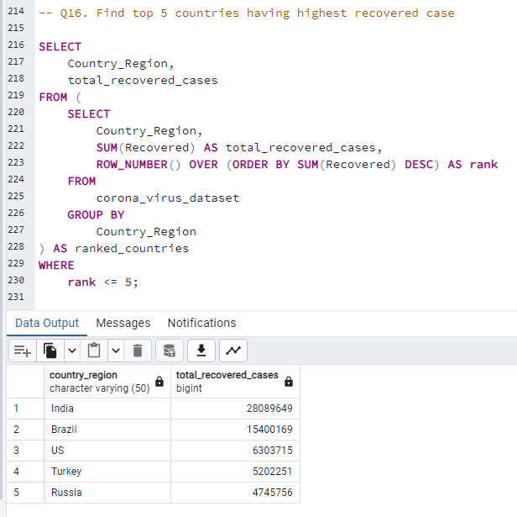
Q16. Find top 5 countries having highest recovered case.

Slide 23





Insights
Here are the key insights from the SQL analysis of the COVID-19 dataset:
The dataset covered the January 22, 2020, to June 13, 2021 pandemic period.
2021 had higher COVID-19 casualties despite fewer cases than 2020.
India reported the maximum number of recovered cases globally.
April 2021 saw a significant spike in confirmed cases worldwide.
Samoa, Kiribati, Dominica, and Marshall Islands had the lowest death counts.
The US had the highest number of confirmed cases, but India had more recoveries in this dataset.
These findings highlight the pandemic's timeline, global distribution of cases and recoveries, peak infection periods, and the most and least affected countries in terms of reported COVID-19 cases and deaths

Slide 24


Thank you

